Slide 1
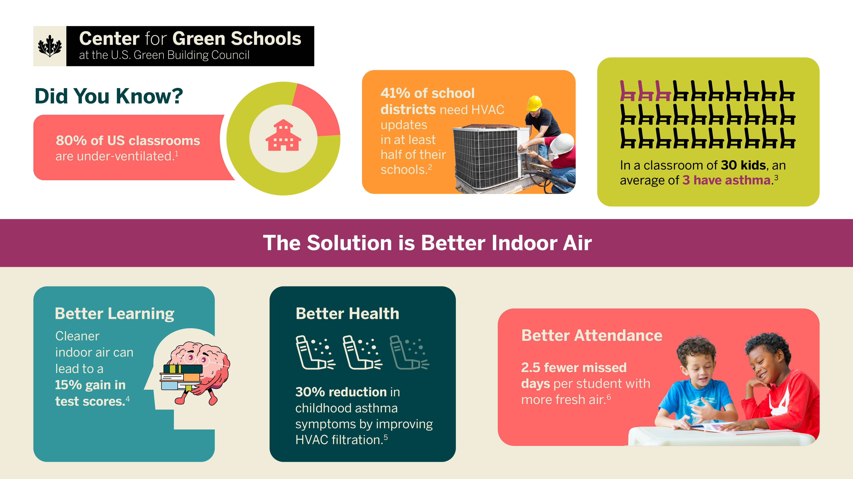
Notes:
Deng, S., Zou, B., & Lau, J. (2021). The adverse associations of classrooms’ indoor air quality and thermal comfort conditions on students’ illness-related absenteeism between heating and non-heating seasons—A pilot study. International Journal of Environmental Research and Public Health, 18(4), 1500. https://doi.org/10.3390/ijerph18041500
U.S. Government Accountability Office. (2020). K–12 education: School districts frequently identified multiple building systems needing updates or replacement (GAO-20-494). https://www.gao.gov/products/gao-20-494
Centers for Disease Control and Prevention. (2024, August 13). Managing asthma in schools. https://www.cdc.gov/school-health-conditions/chronic/asthma.html
Shaughnessy, R. J., Haverinen-Shaughnessy, U., Nevalainen, A., & Moschandreas, D. (2006). A preliminary study on the association between ventilation rates in classrooms and student performance. Indoor Air, 16(6), 465–468. https://onlinelibrary.wiley.com/doi/10.1111/j.1600-0668.2006.00440.x
Martenies, S. E., & Batterman, S. A. (2019). Effectiveness of using enhanced filters in schools and homes to reduce indoor exposures to PM2.5 from outdoor sources and subsequent health benefits for children with asthma. Environmental Science & Technology, 53(13), 7465–7476. https://doi.org/10.1021/acs.est.8b02053
Wargocki, P., Porras-Salazar, J. A., Contreras-Espinoza, S., & Bahnfleth, W. P. (2020). The relationships between classroom air quality and children's performance in school. Building and Environment, 173, Article 106749. https://www.sciencedirect.com/science/article/abs/pii/S0360132320301074
*Finding calculation: Ventilation increase from 2 L/s to 8 L/s per person = 1.5% attendance increase x 180 school days = 2.7 fewer missed school days per student per year.

